Slide 1
Unix Basic Commands

Slide 2
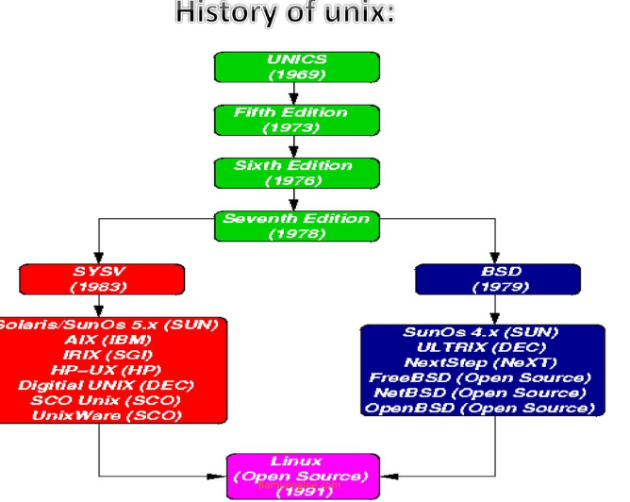

Slide 3
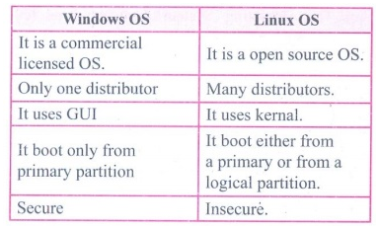

Slide 4
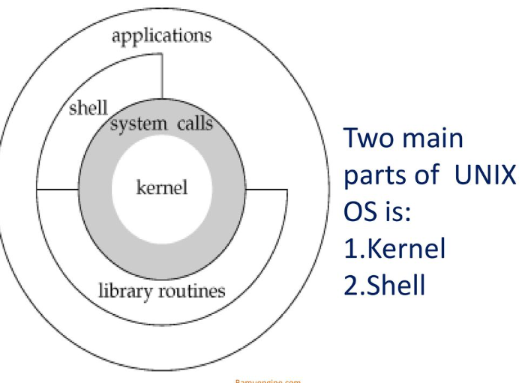

Slide 5
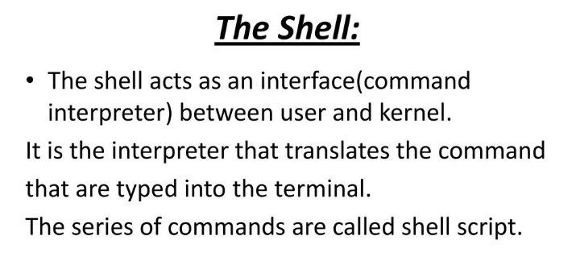

Slide 6
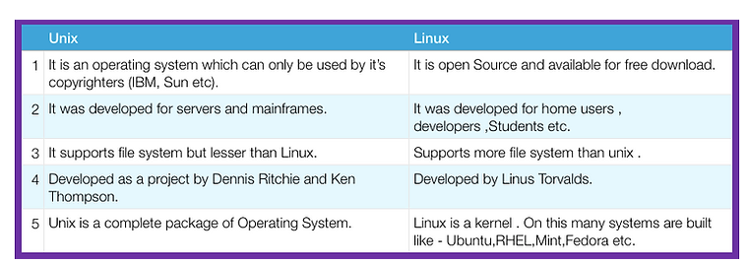
Linux is Unix-Like operating system.

Slide 7
Basic Linux Command
pwd - Shows the present working directory
whoami - Gives the current username
date - Gives current the date and time
history - Shows all commands you have typed in recently
cp - Used to copy a file
rm - To delete a file
Sudo su-change to root directory

Slide 8
Basic Linux Command
clear - Clears the content of the entire terminal.
man - It's a guide to the commands.
exit - Exit and close the running terminal.
who - Shows the logged-in user of the system.
w - Same as who and also show the current process
mkdir - Used to make directory

Slide 9
cat - Display the content of the file.
mv - Used to move file /folder from source to destination.
alias- Give a name for the command and execute using it.
echo - Prints text on terminal
ls - List file and folder

